Slide 1


Closed-loop learning clustering and data autophagy
Gabriele Cerioli
Supervisor: Matteo Marsili

Slide 2
What is machine learning?
Algorithms that allow computer to learn from data
Improve performance on a task without being explicitly programmed
Data preprocessing
Model training
Model evaluation
Prediction/Inference

Slide 3
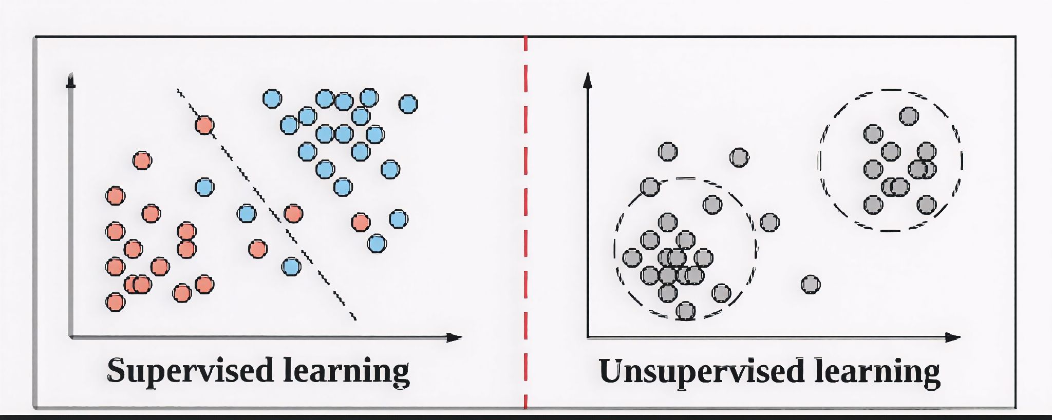
Supervised learning Unsupervised learning
The model is trained on labeled data
Must find hidden patterns in the dataset on its own

Slide 4
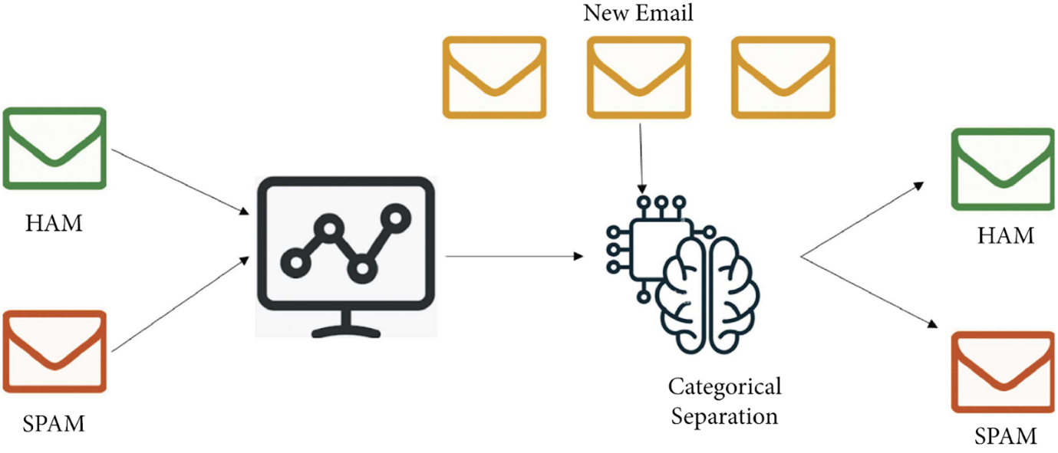
Supervised learning: Email spam classification
Train with million of spam and non spam emails
Data preprocessing
Test it with new emails
We can now use the model
That’s why sometimes Gmail asks you if the email is to be considered spam. To gain new human-supervisioned data to further train their model

Slide 5
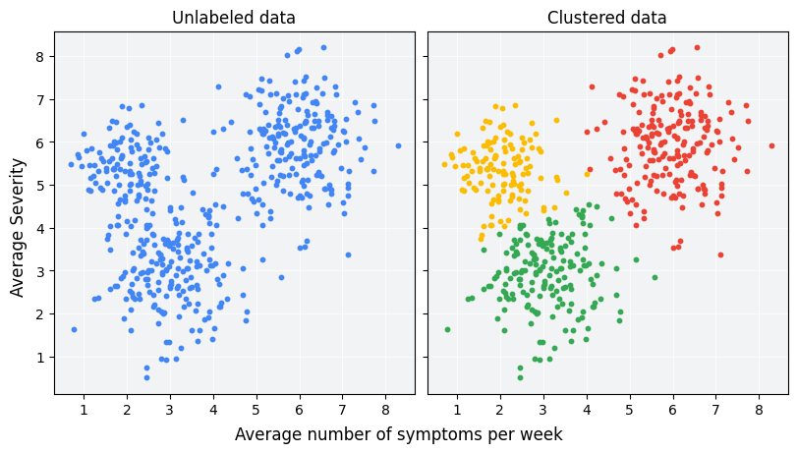
Unsupervised learning: Clustering problems

Slide 6
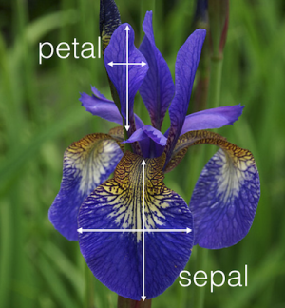
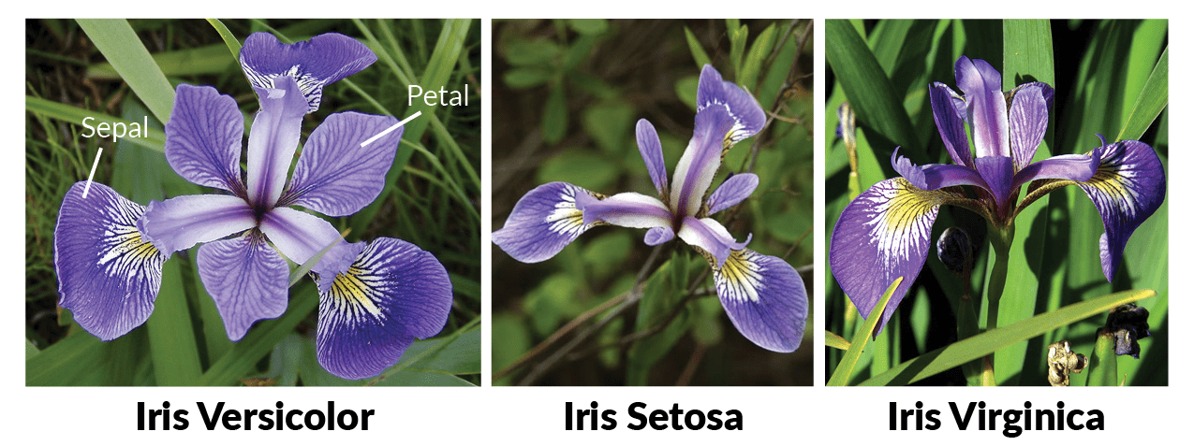
Iris flower dataset: an interesting playground
Data about three different plant species collected in 1936 by Ronald A. Fisher
150 samples with 50 samples for each species of Iris flowers
We have 4 measures for each sample

Slide 7
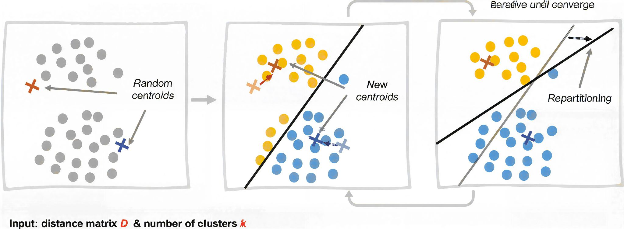
K-means algorithm
Initialization: choose K random centroids
Assignment step: assign each point to the closest cluster
Update step: centroids are recalculated using the mean of each cluster
REPEAT TO CONVERGENCE

Slide 8
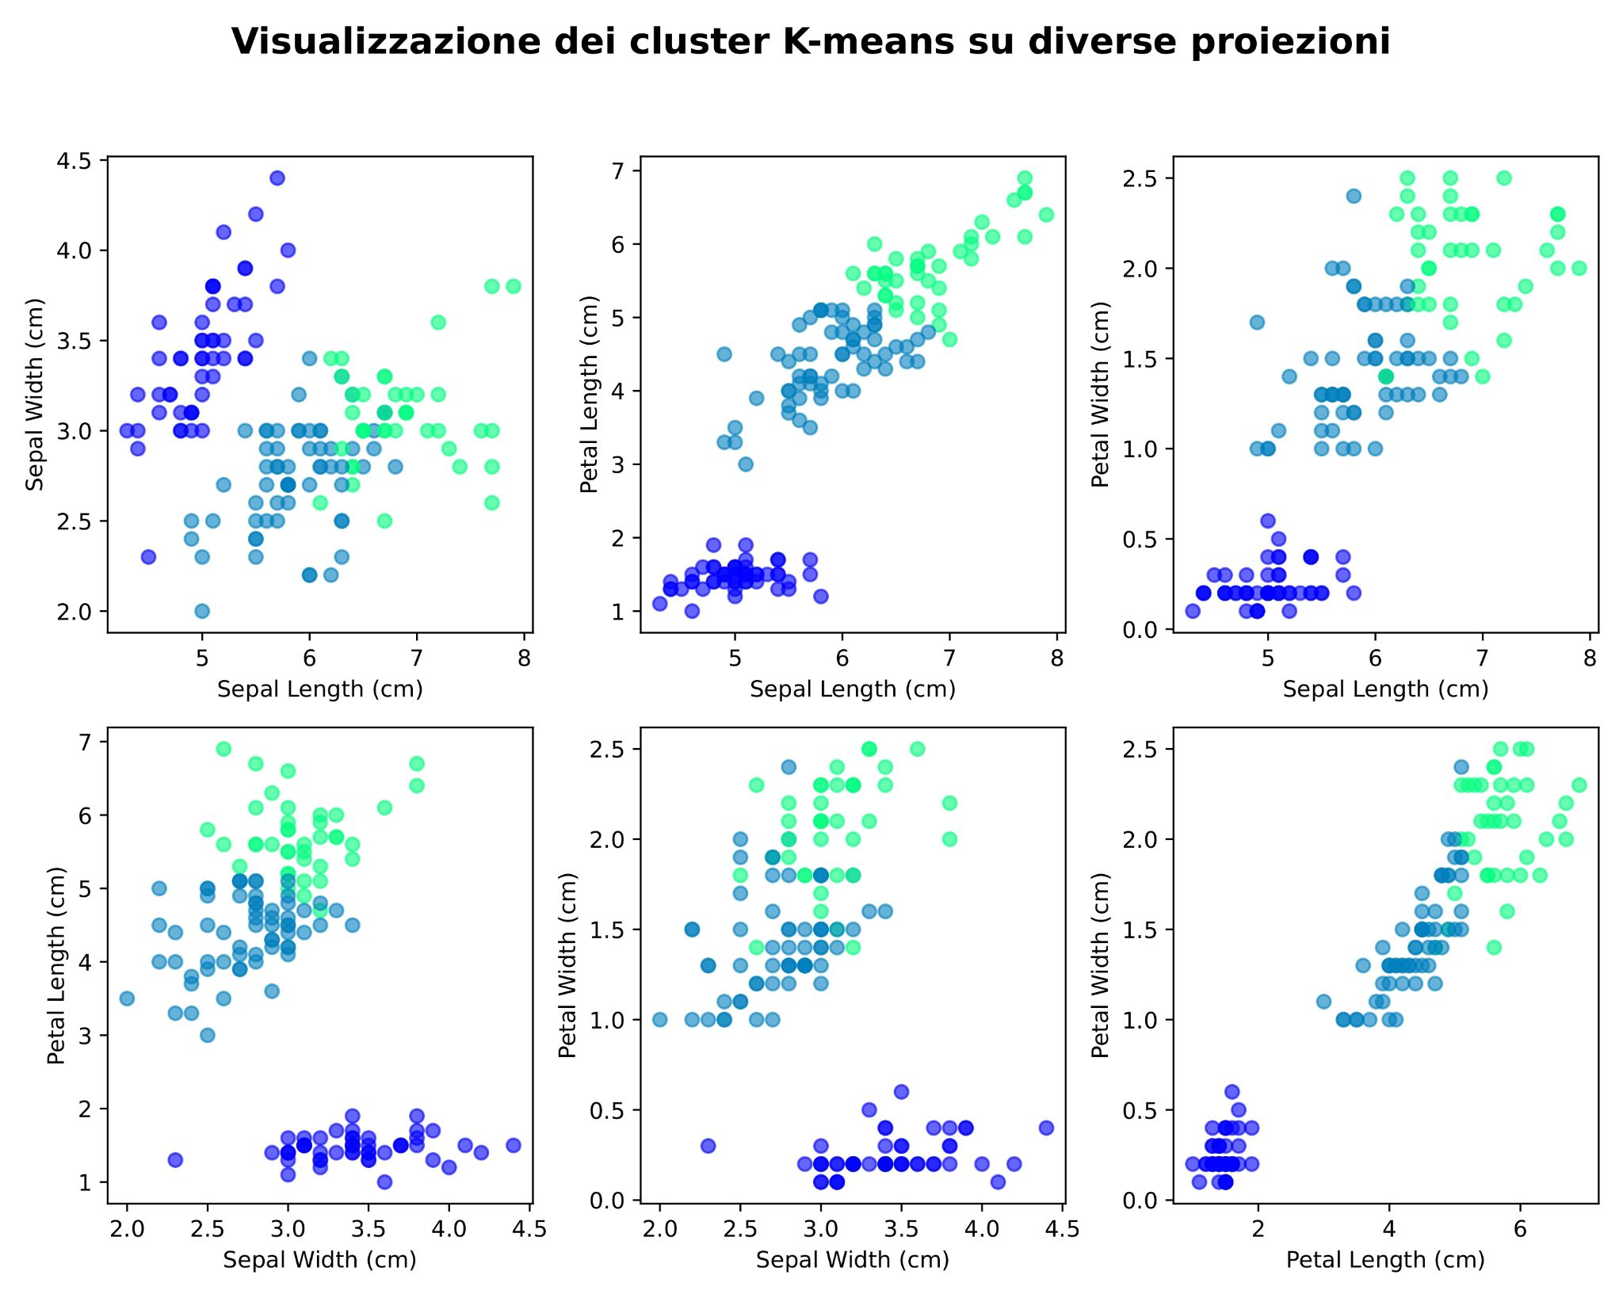
K-means on Iris dataset

Slide 9
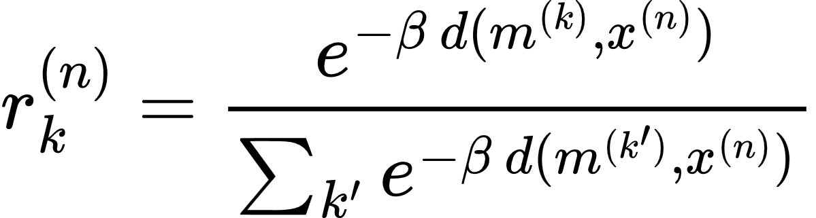
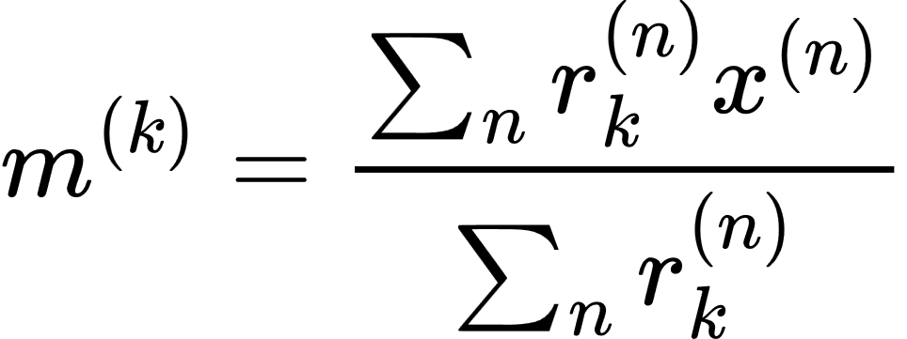
Soft/Fuzzy K-means algorithm
The main difference is that we don’t force each data point to belong to only one cluster (hard assignments) but we define a degree of membership (responsibility r) to each cluster.
Now the updating of the centroids is a weighted means, where the weights are the responsibilities r.

Slide 10

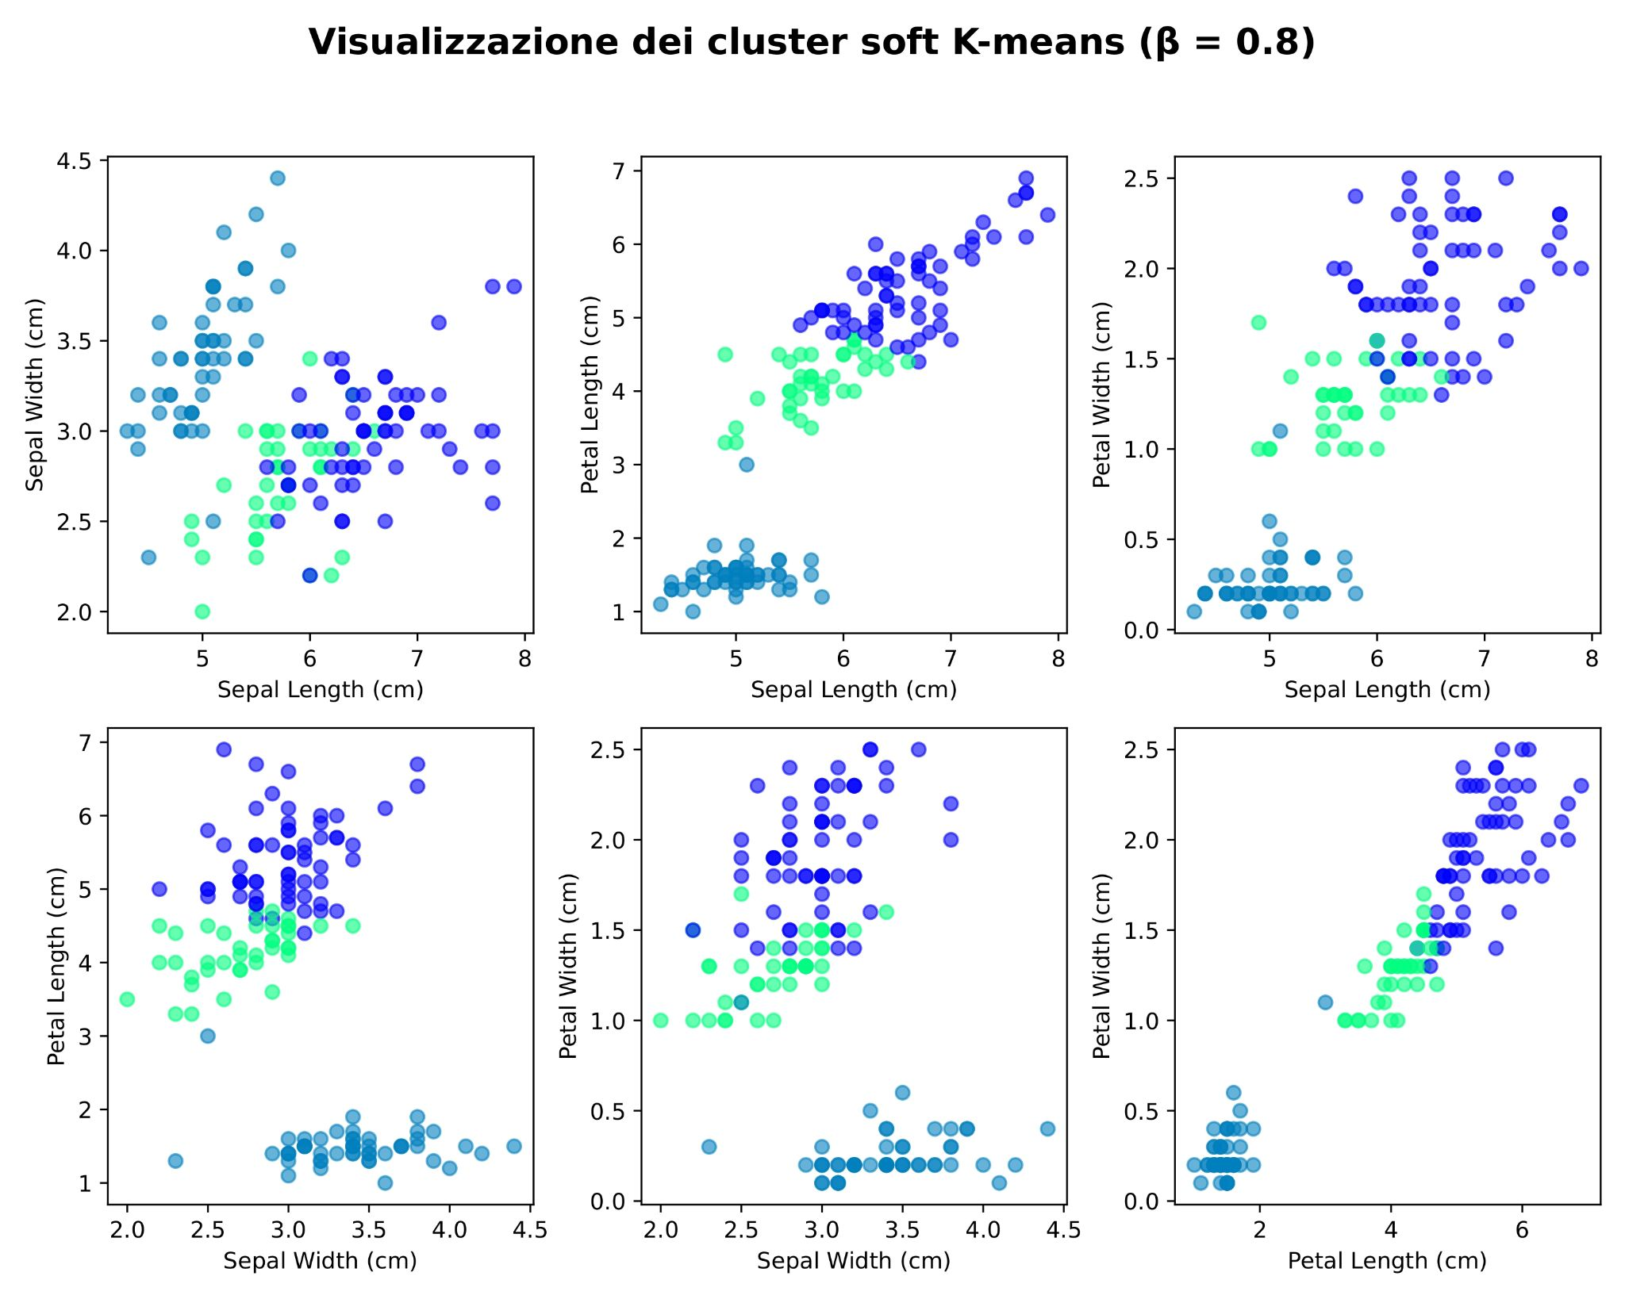
Soft K-means on Iris Dataset with stiffness

Slide 11
How to evaluate the clustering quality?

Slide 12

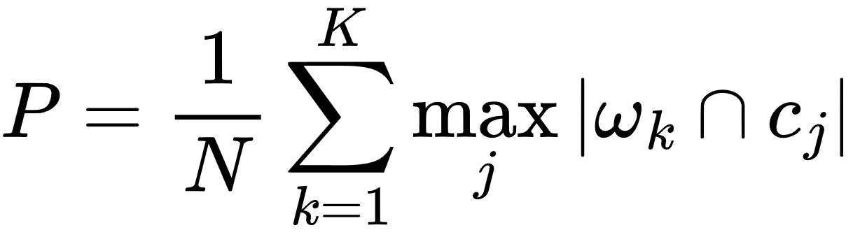
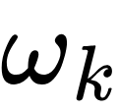
Purity Score
To calculate the purity score we need the ground truth ( )
is the set of points in the cluster k

Slide 13
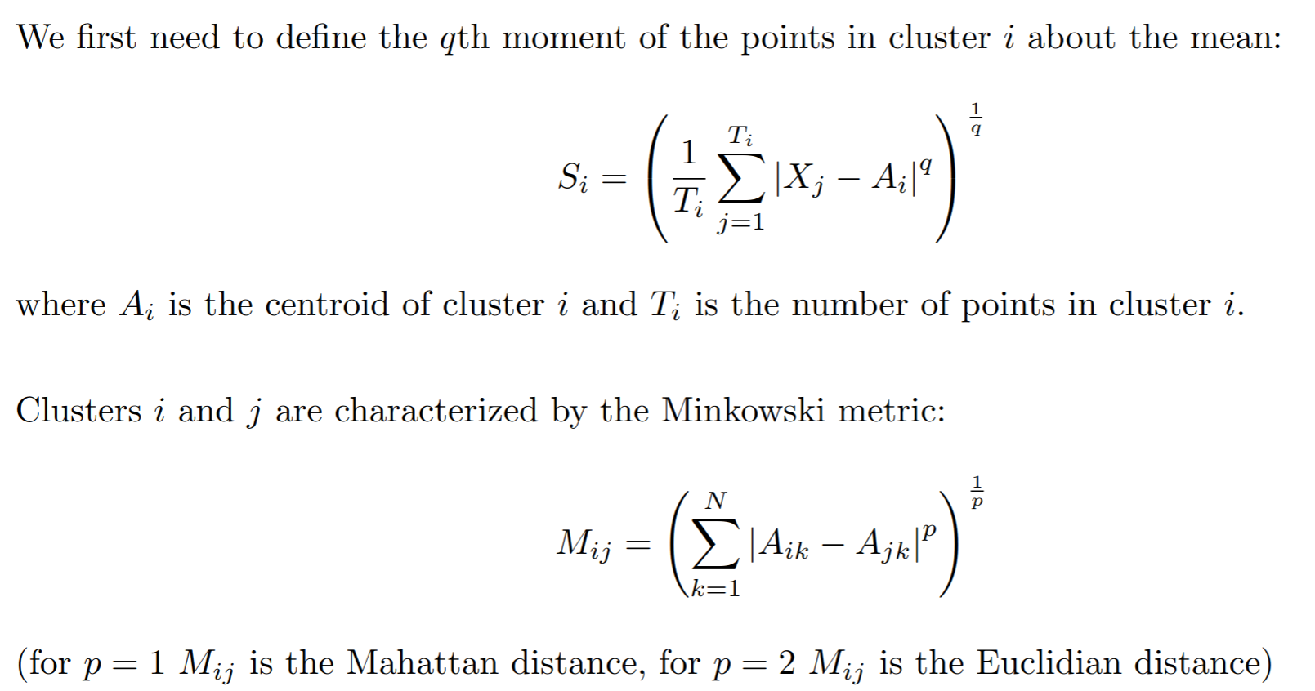
Davies-Bouldin Index (internal metric)

Slide 14
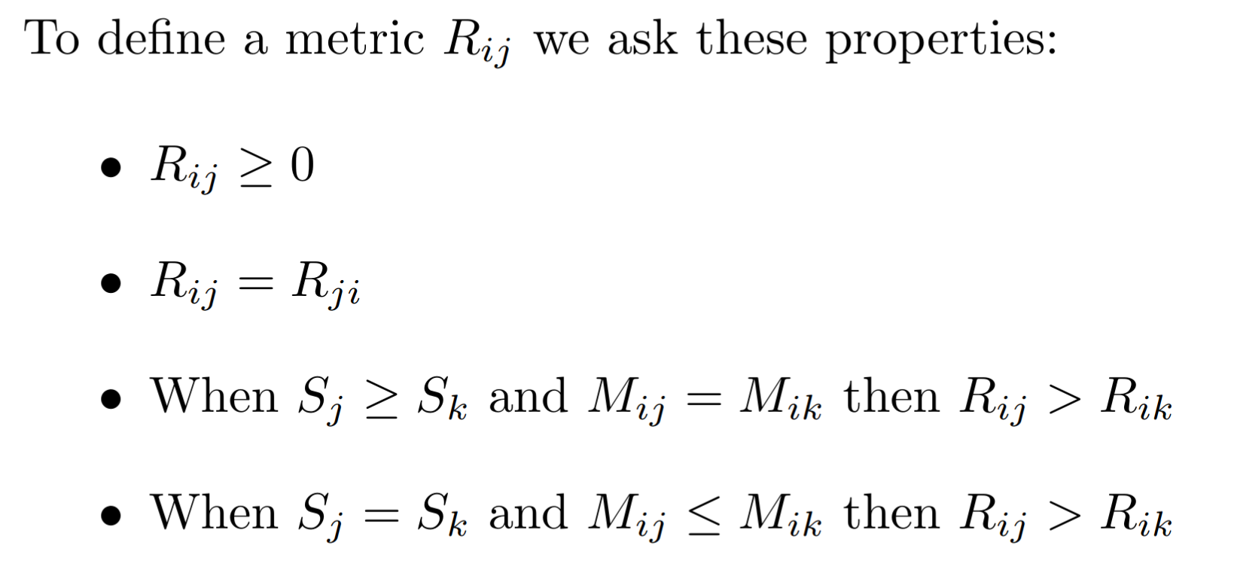
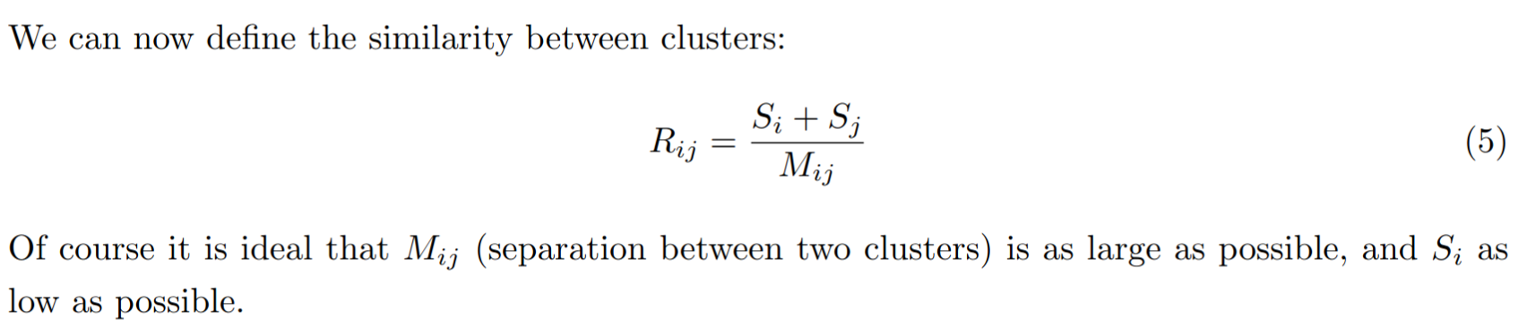

Slide 15
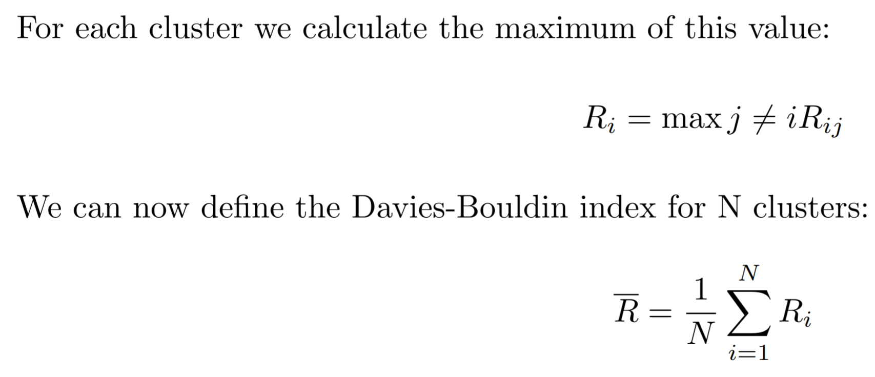
We expect the index to be as little as possible

Slide 16

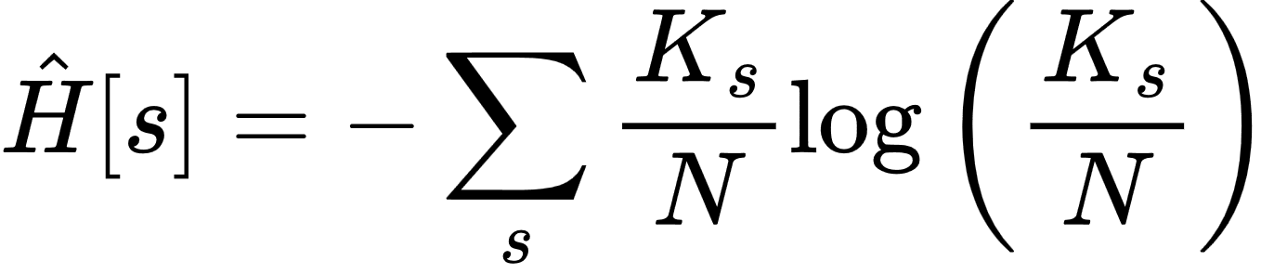
Infomax based metric
Since we know that the information collected by the dataset can be quantifies by the Shannon entropy, we can take the entropy as a metric:

Slide 17
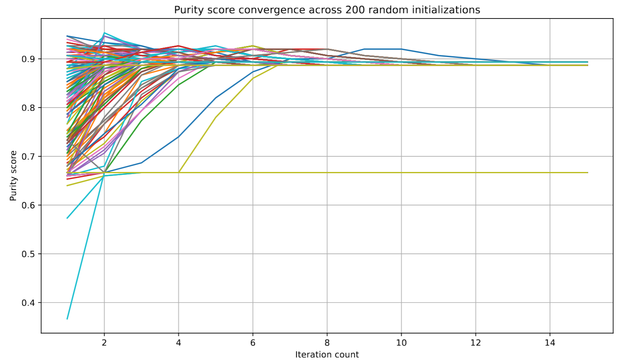
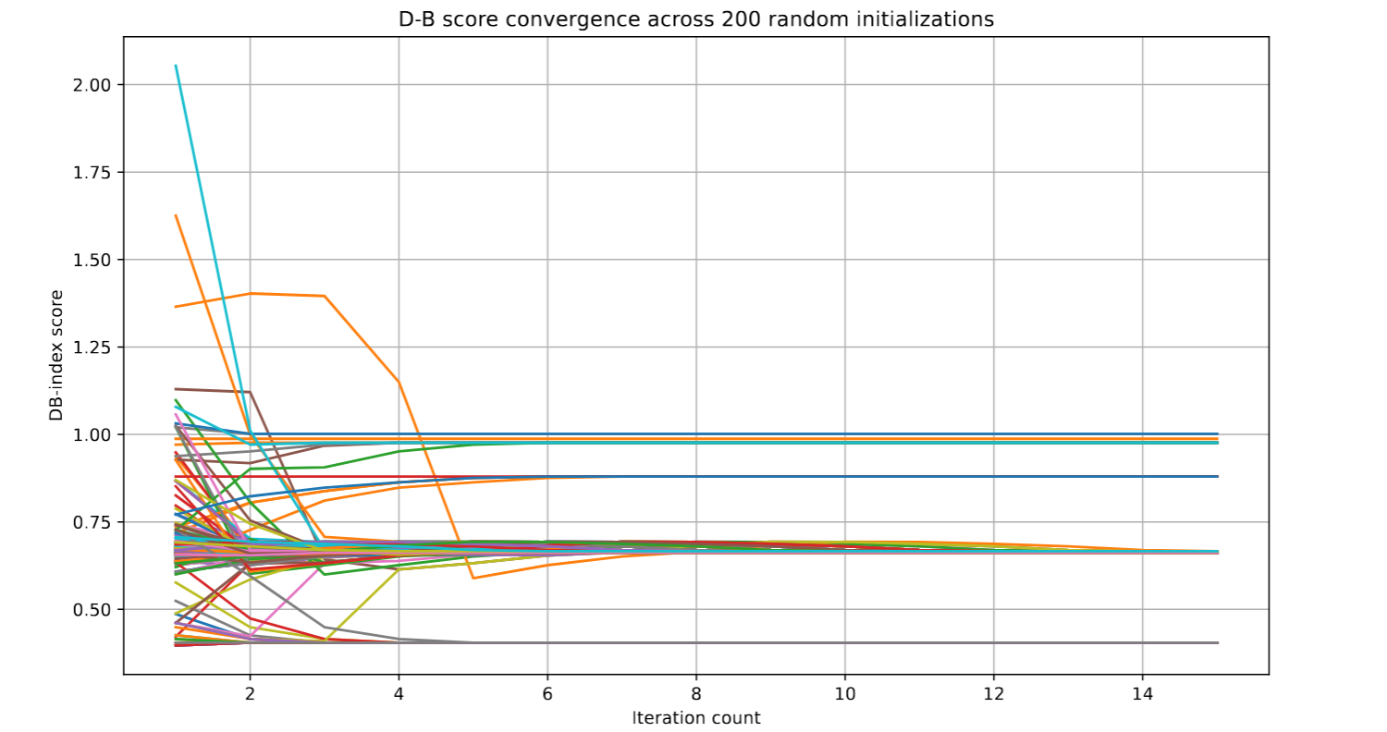
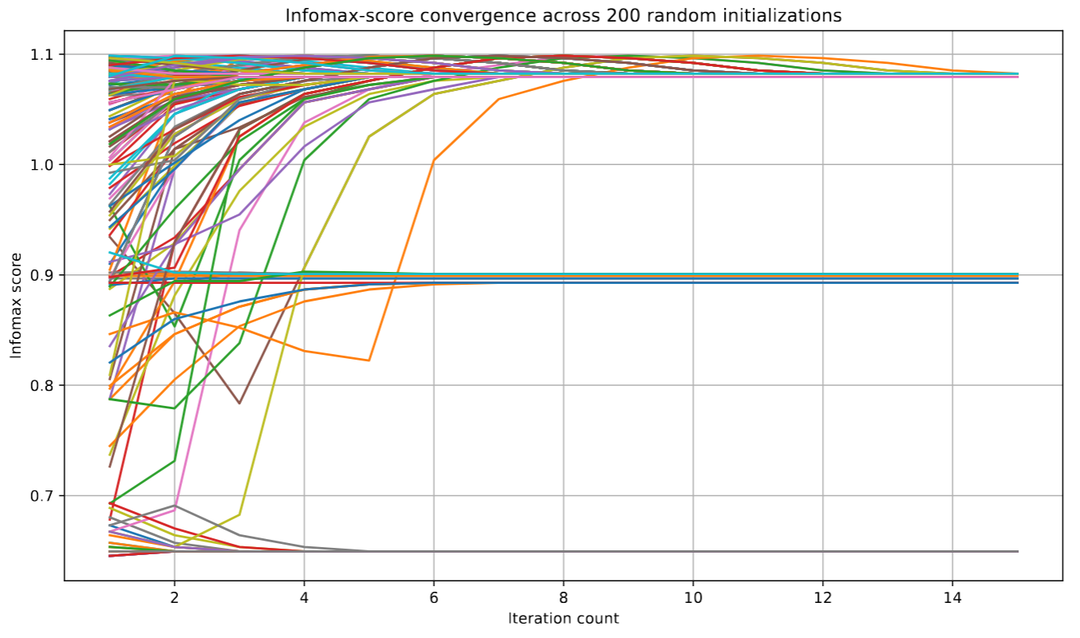
Kmeans evaluation

Slide 18
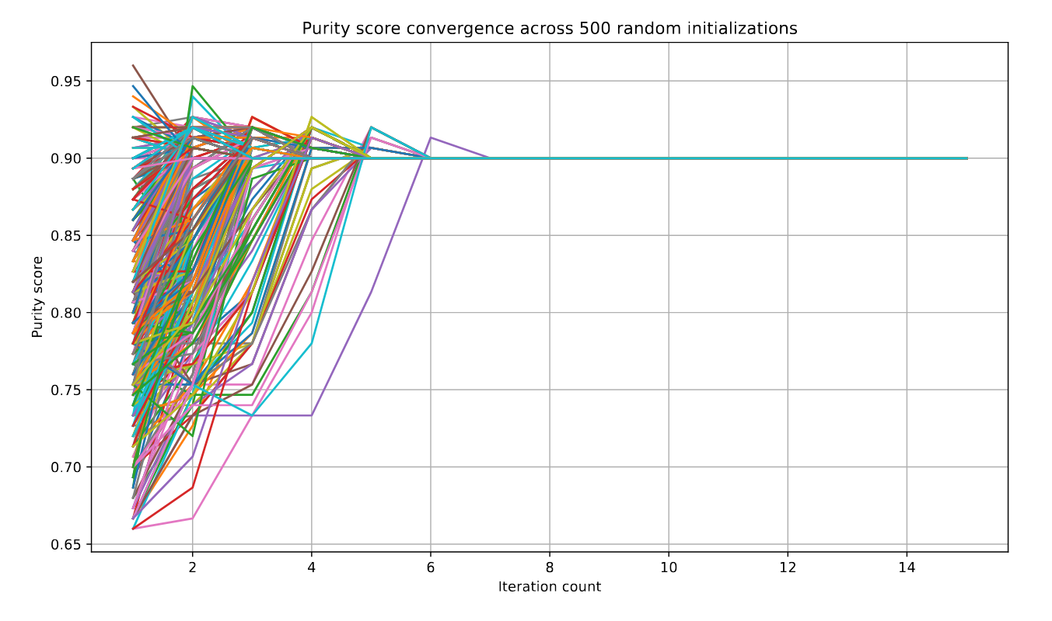
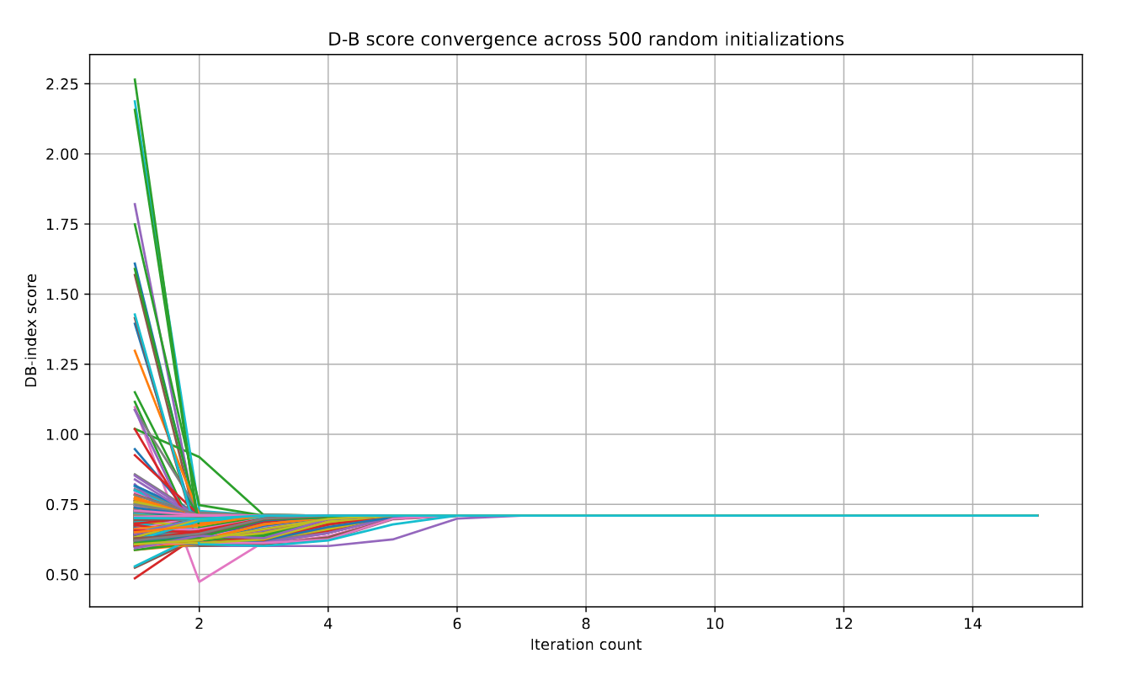
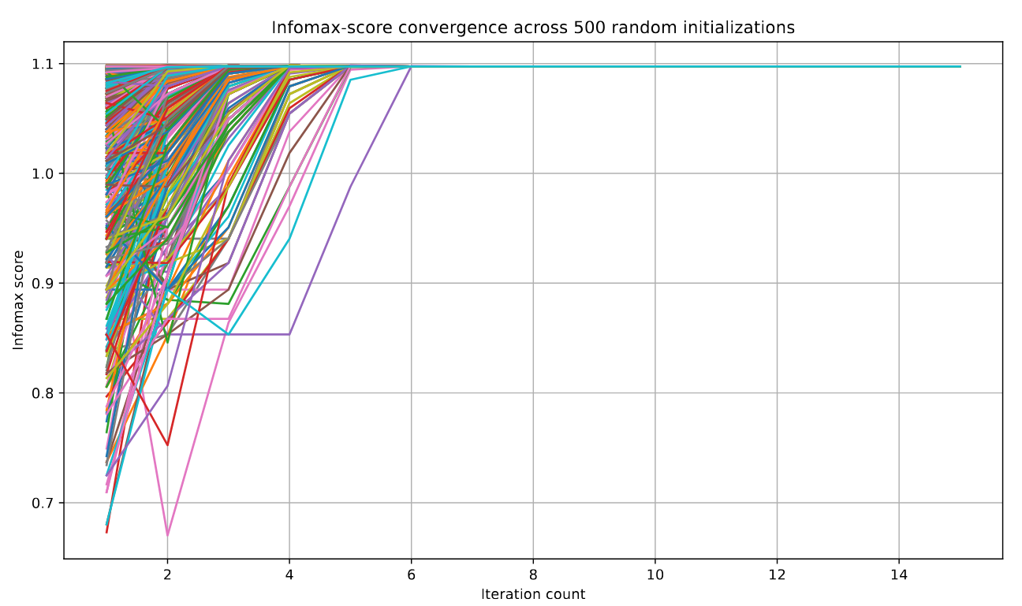
Soft Kmeans evaluation

Slide 19
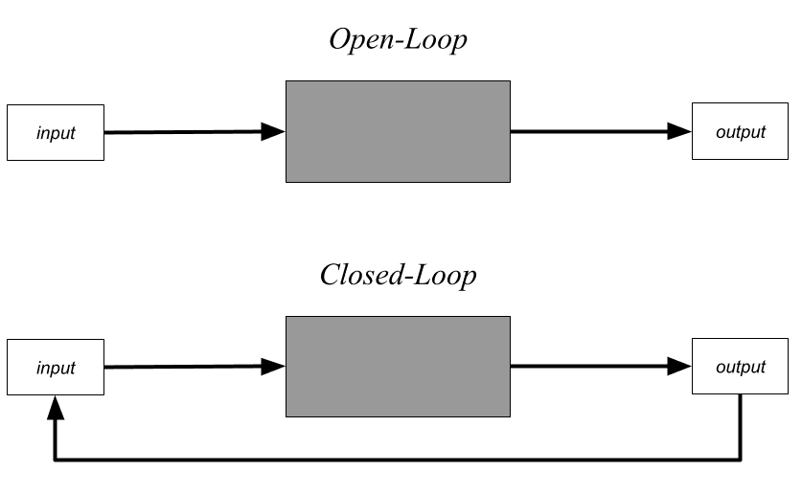
What is Closed-loop learning?

Slide 20
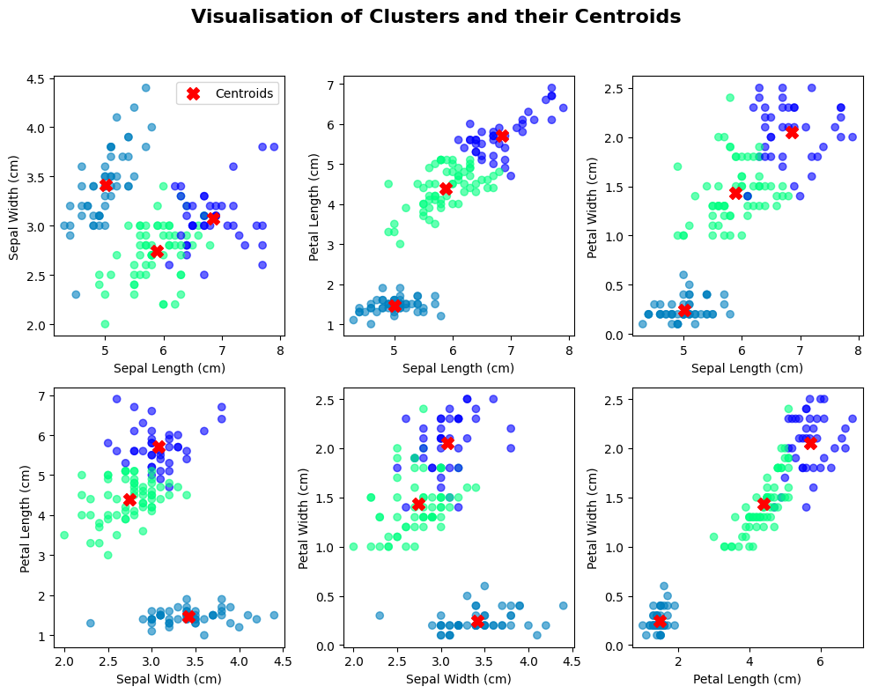
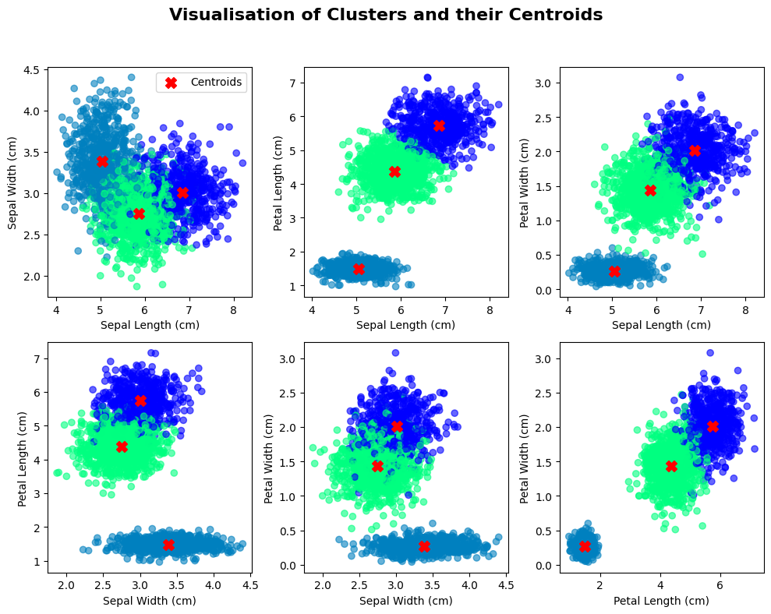
Our Closed-loop learning algorithm
After doing a first K Means clustering, we add M synthetic points (generated from the clusters Gaussian mixture), and repeat this cycle multiple times.

Slide 21
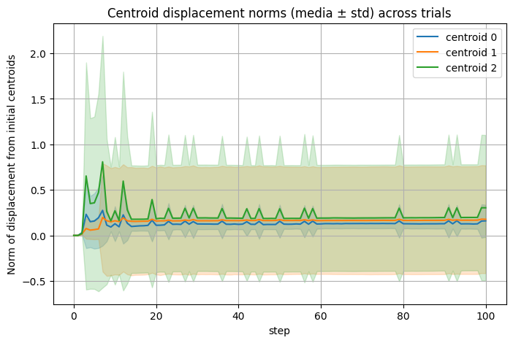
CLL as an evaluation of clustering quality
Firstly we compute the displacement of the centroids after the CLL execution.

Slide 22
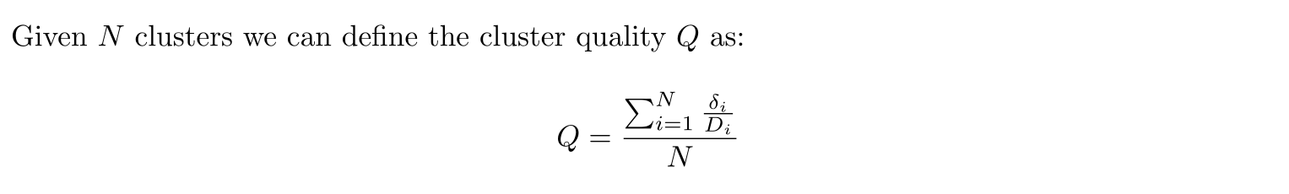
CLL as an evaluation of clustering quality
Then we confront the displacements with the distances between the original centroids
We expect this value to be as low as possible for a good clustering

Slide 23
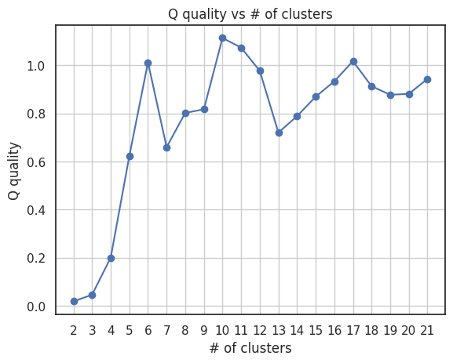
Can we use the CLL quality to find out the optimal number of clusters?

Slide 24
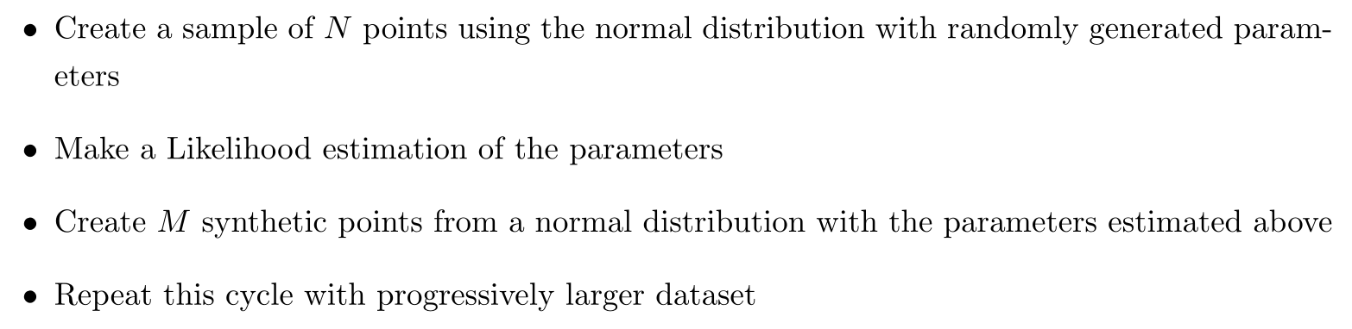
CLL as an inference device
The problem is the following:

Slide 25
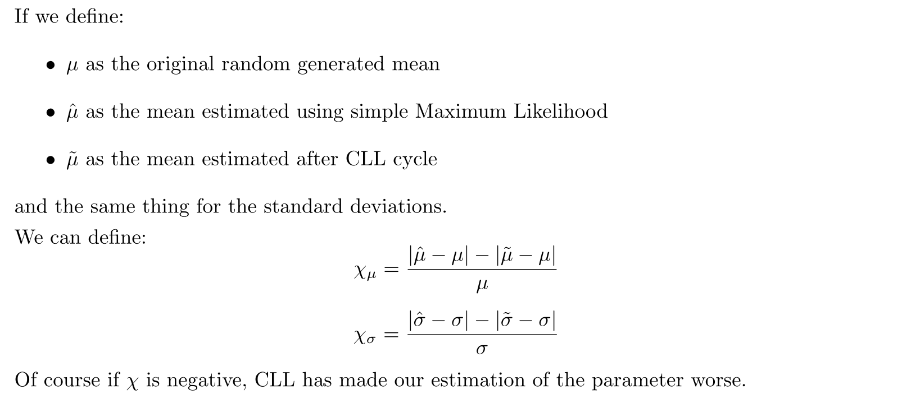
CLL as an inference device

Slide 26
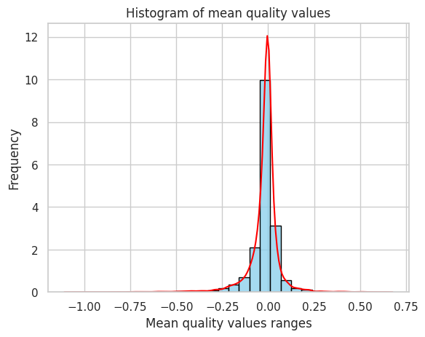
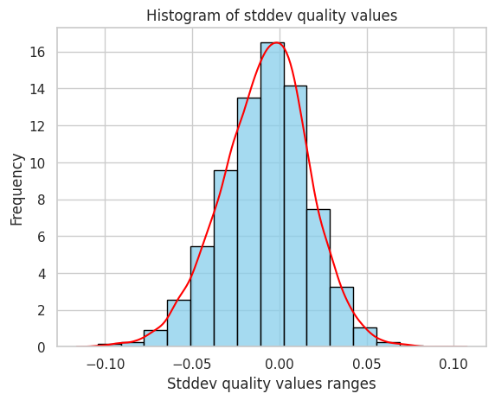
CLL as an inference device
If we iterate this algorithm 1000 times we get:
So it seems it doesn’t work…

Slide 27
Data Autophagy

Slide 28
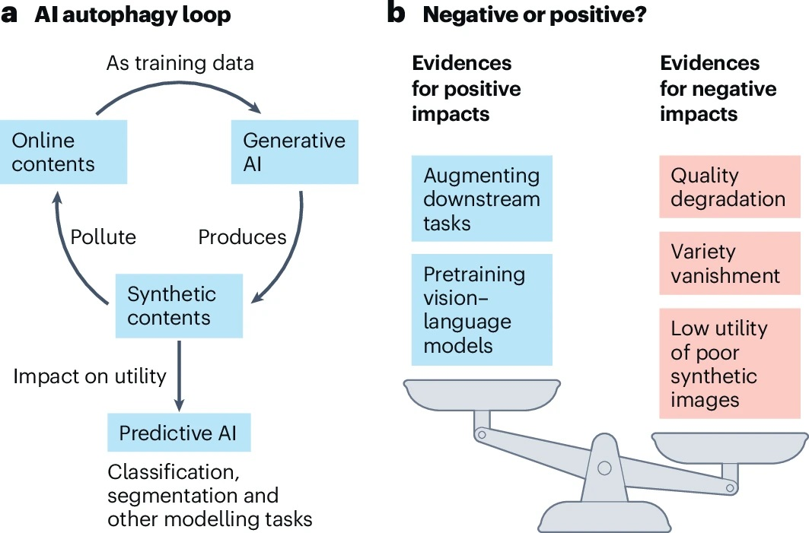
What is Data Autophagy?
When generative AI models are increasingly trained on content that was also AI generated

Slide 29
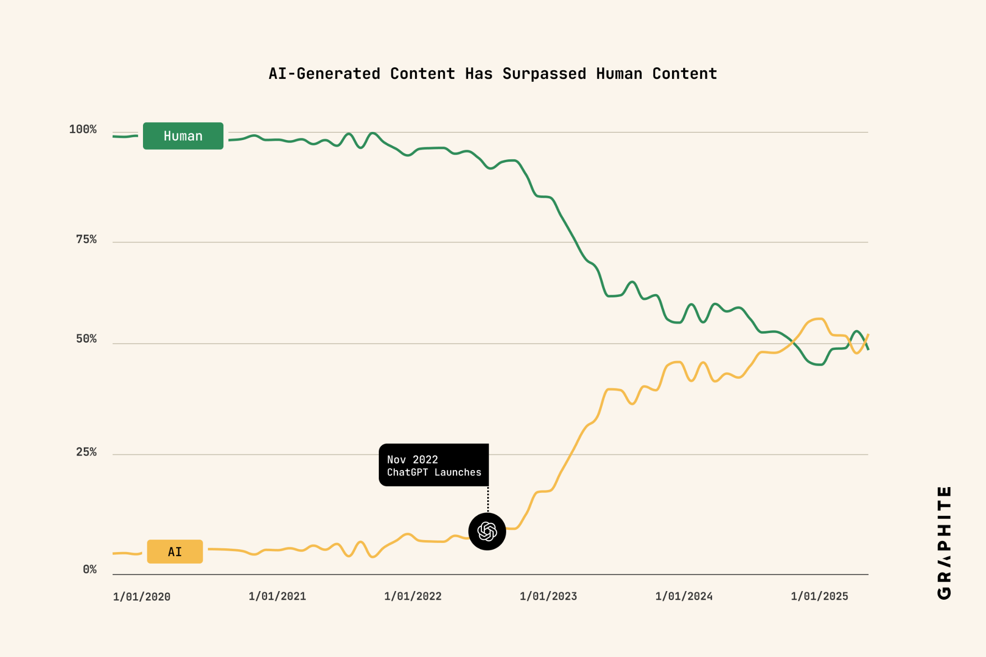
Why is it a problem?
The supply of high-quality human generated data is running out.
A possible outcome of data autophagy is model collapse, where the models lose the diversity of the original data

Slide 30
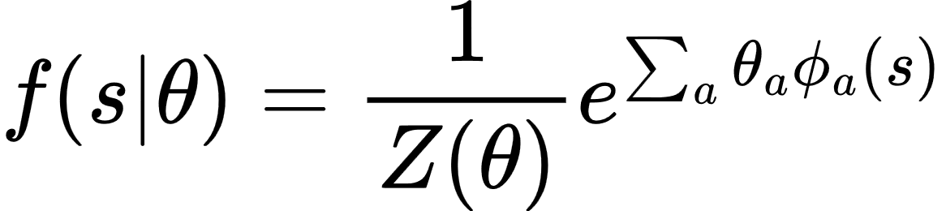
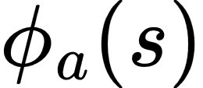
How can we prevent the inevitable model collapse?
GOOD NEWS
If you train a model using Maximum Likelihood on Purely Self-generated Data the model collapse is inevitable
If you use a Maximum A Posteriori (MAP) regularization, it introduces a small external force that prevents model collapse
If you include a small amount of non-AI-generated data (even one point) it is enough to prevent model collapse
BAD NEWS
Where are bounded functions of s
It is demonstrated to only work for Exponential Families models by Marsili-Roudi-Jangjoo (July 2025)

